Slide 1

CAPSTONE PROJECT
Restaurant revenue prediction
Presented By:
VISHAL K S(2021306052)
Department of Leather Technology Alagappa College of Technology
Anna university

Slide 2
OUTLINE
Problem Statement
Proposed System/Solution System Development Approach Algorithm & Deployment Result
Conclusion
Future Scope
References

Slide 3
Problem Statement
"Increasing restaurant revenue through predictive analytics“

Slide 4
Proposed Solution
*Data Collection and Preprocessing:
Gather historical data on restaurant sales, including daily or weekly revenue figures, menu items, pricing, promotions, weather conditions, and other relevant variables.
*Exploratory Data Analysis (EDA):
Conduct exploratory data analysis to gain insights into the dataset. Visualize relationships between variables, identify patterns, trends, and correlations that may influence restaurant revenue.
*Model Selection and Training:
Choose appropriate machine learning algorithms for regression tasks, such as linear regression,
decision trees, random forests, gradient boosting, or neural networks.
*Monitoring and Maintenance:
Continuously monitor the model's performance in production, tracking forecast accuracy and identifying any deviations or anomalies.

Slide 5
System Approach
*Feedback Loop:
Establish a feedback loop to gather insights from restaurant stakeholders and incorporate user feedback into model refinement and future iterations.
*Deployment:
Deploy the trained model into a production environment, either as a standalone application or integrated into existing restaurant management systems. Ensure scalability, reliability, and real-time processing capability.

Slide 6
Algorithm & Deployment
1)Algorithm Selection:
Time Series Forecasting Algorithms: Time series forecasting methods like ARIMA (AutoRegressive Integrated Moving
Average) or SARIMA (Seasonal ARIMA) are suitable for modeling temporal patterns in restaurant revenue data,
accounting for seasonality and trends.
Machine Learning Regression Models: Regression algorithms such as Linear Regression, Random Forest Regression, or
Gradient Boosting Regression can capture complex relationships between various factors (e.g., menu items, pricing,
weather) and restaurant revenue.
2)Data Preparation:
Preprocess the data by cleaning, normalizing, and encoding features. Extract relevant features such as sales volume,
menu popularity, seasonality indicators, and external factors like weather conditions.
Split the data into training and testing sets, ensuring that the training set contains historical data and the testing set
represents future periods for evaluation.

Slide 7
ALGORITHM & DEPLOYMENT
3)Model Training and Evaluation:
Train the selected algorithm(s) on the training data, optimizing hyperparameters through techniques like cross-
validation or grid search.
Evaluate model performance using appropriate evaluation metrics such as Root Mean Squared Error (RMSE), Mean
Absolute Error (MAE), or Mean Absolute Percentage Error (MAPE) on the testing set.
4)Ensemble Methods (Optional):
Explore ensemble techniques like model averaging or stacking to combine predictions from multiple algorithms and
potentially improve prediction accuracy.
5)Model Deployment:
Deploy the trained model into a production environment, either as a standalone application or integrated into existing
restaurant management systems.
Implement a RESTful API or web interface for easy interaction with the model, allowing stakeholders to input relevant
variables (e.g., menu items, pricing) and receive revenue predictions in real-time.

Slide 8
ALGORITHM & DEPLOYMENT
6)Monitoring and Maintenance:
Monitor model performance in production, tracking prediction accuracy and detecting any deviations or
anomalies.
Periodically retrain the model with new data to adapt to changing trends and ensure continued accuracy over
time.
7)Feedback Loop:
Establish a feedback mechanism to gather input from restaurant owners, managers, and other stakeholders
regarding the usefulness and accuracy of the revenue predictions.
Incorporate user feedback into model refinement and future iterations to enhance prediction quality and meet
evolving business needs.

Slide 9
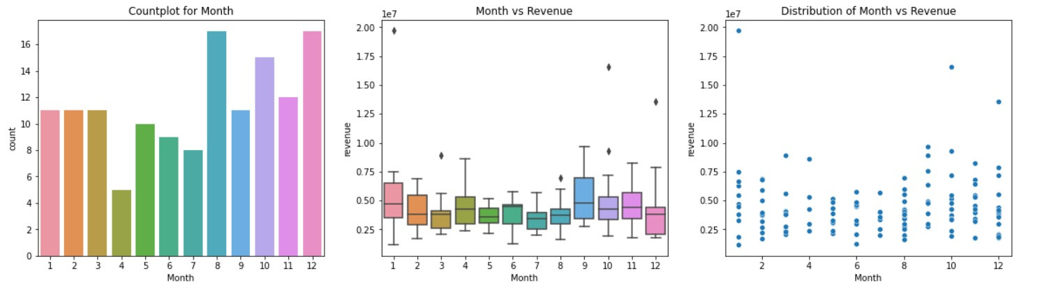
RESULT

Slide 10
CONCLUSION
By addressing the challenges identified and leveraging the insights gathered from stakeholders, we can create impactful tools that empower restaurant owners and managers to make data-driven decisions and achieve greater success in the dynamic restaurant industry.

Slide 11
FUTURE SCOPE
*100% of restaurant owners reported that automation and technology have improved their businesses, and they're using them in new, innovative ways to drive success. Another 54% plan to increase their spending on certain technology and automation tools in 2024.
*The Global Restaurants market is anticipated to rise at a considerable rate during the forecast period, between 2023 and 2030. In 2022, the market is growing at a steady rate and with the rising adoption of strategies by key players, the market is expected to rise over the projected horizon

Slide 12
REFERENCES
https://www.kaggle.com/code/mohammadsabeti/hotel-booking-dataset- analysis/notebook
https://seaborn.pydata.org/
https://matplotlib.org/stable/contents.html

Slide 13
THANK YOU

